Slide 1
Cyber forensics
Module 1

Slide 2
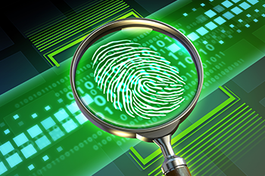
Forensics
Meaning: Scientific tests or techniques used in connection with the detection of crime.

Slide 3
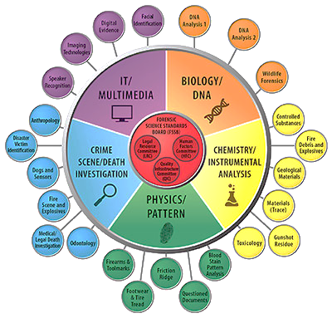

Slide 4


Slide 5
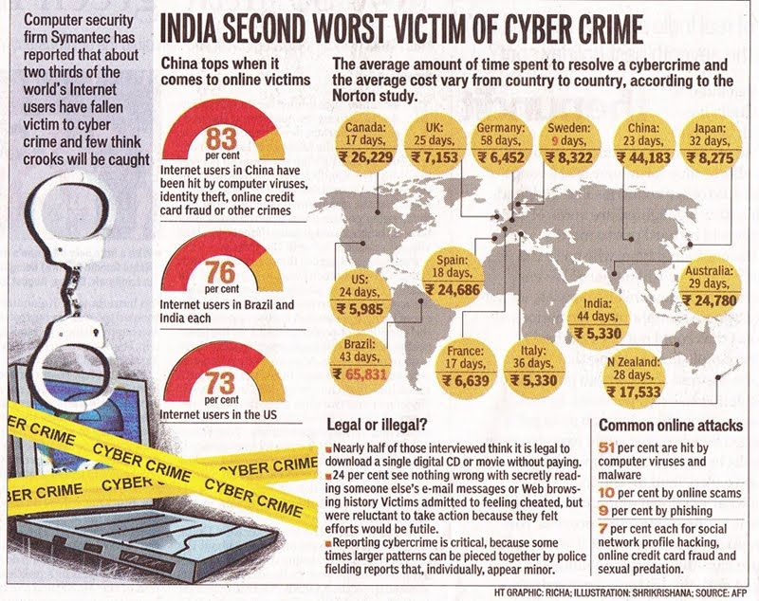
Introduction –Orientation

Slide 6
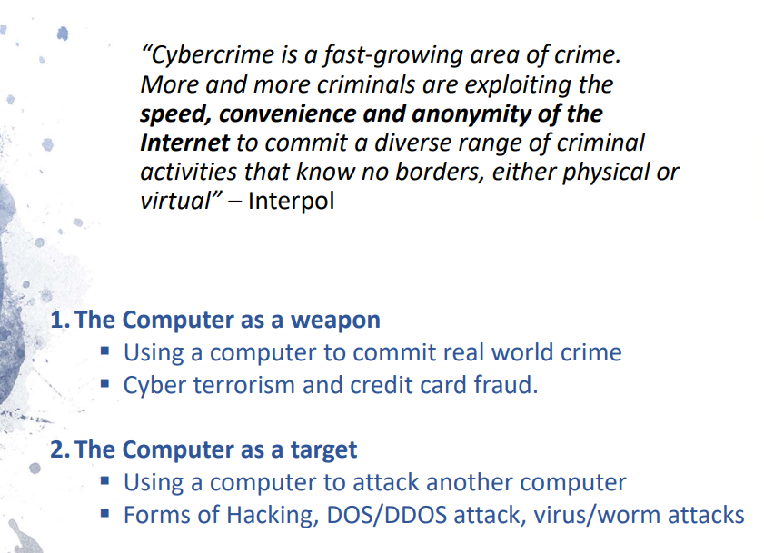

Slide 7
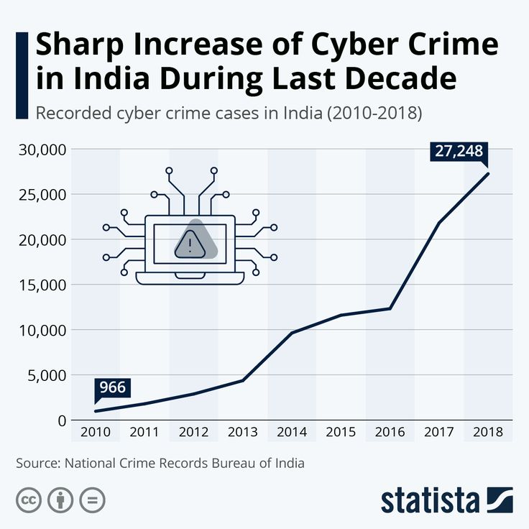
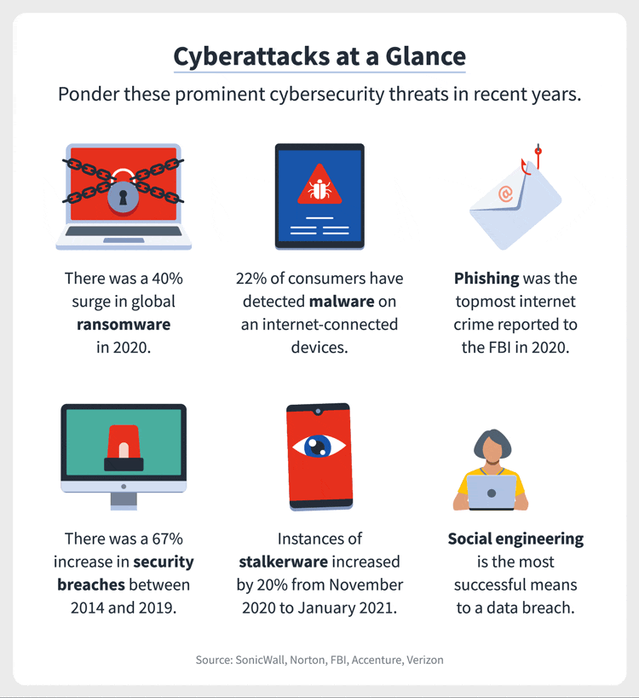

Slide 8
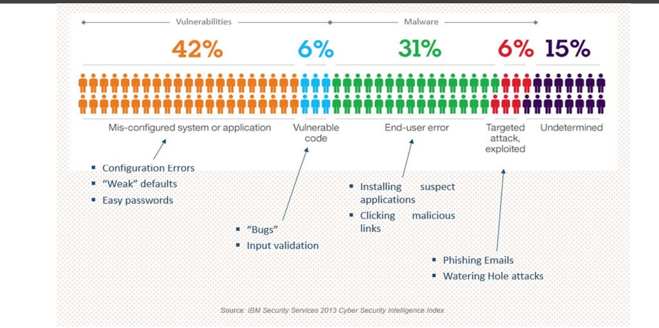

Slide 9
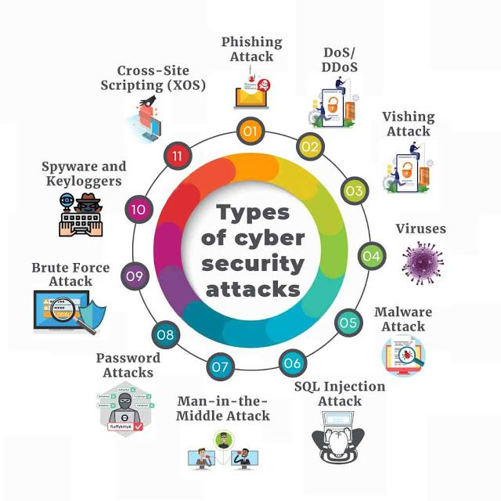
Introduction –Orientation

Slide 10
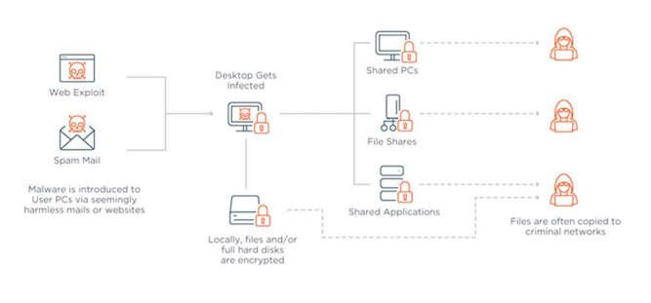
Ransomware Attack 2017

Slide 11
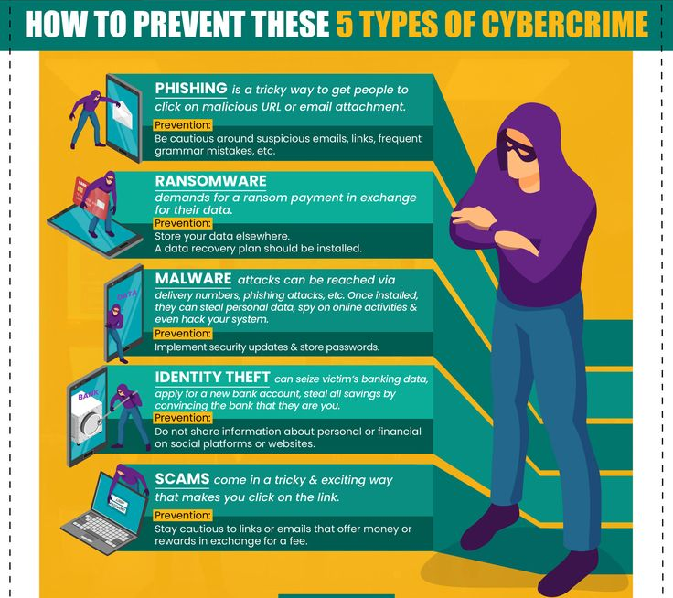

Slide 12
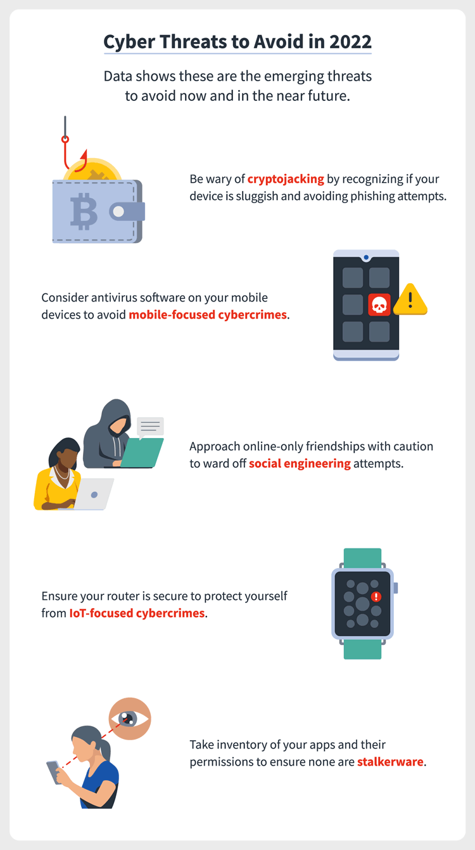

Slide 13
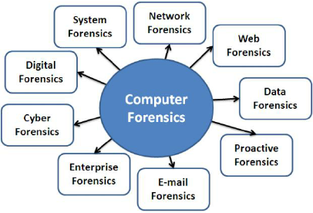

Slide 14
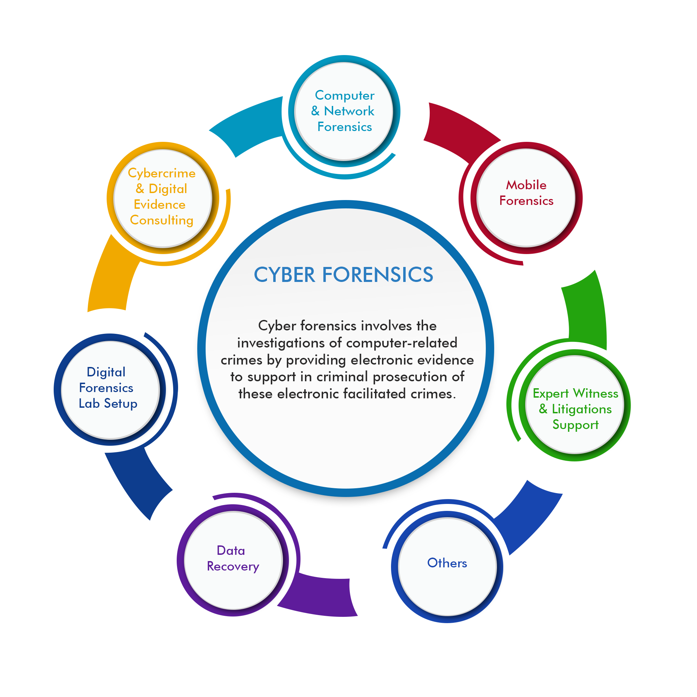

Slide 15

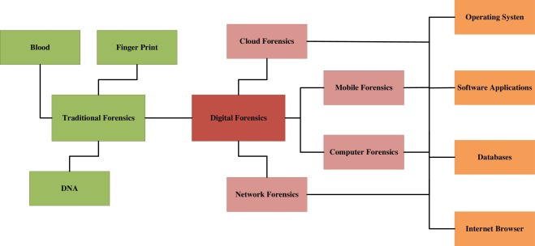

Slide 16
Disk Forensics: It deals with extracting raw data from primary or secondary storage of the device by searching active, modified, or deleted files.
Network Forensics: It is a sub-branch of Computer Forensics which involves monitoring and analysing the computer network traffic.
Database Forensics: It deals with the study and examination of databases and their related metadata.
Malware Forensics: It deals with the identification of suspicious code and studying viruses, worms, etc.
Email Forensics: It deals with emails and its recovery and analysis, including deleted emails, calendars, and contacts.
Memory Forensics: Deals with collecting data from system memory (system registers, cache, RAM) in raw form and then analysing it for further investigation.
Mobile Phone Forensics: It mainly deals with the examination and analysis of phones and smartphones and helps to retrieve contacts, call logs, incoming, and outgoing SMS, etc. and other data present in it.

Slide 17
EVOLUTION OF COMPUTER FORENSICS
The field of computer forensics began to evolve more than 30 years ago.
The field began in the United States, in large part, when law enforcement and military investigators started seeing criminals get technical.

Slide 18
EVOLUTION
In 1984, FBI Magnetic Media program, which was later renamed to Computer Analysis and Response Team (CART), was created and it is believed to be the beginning of computer forensic.
By the early 1990s, specialized tools for computer forensics were available. The International Association of Computer Investigative Specialists (IACIS) introduced training on software for forensics investigations.
In 1998, G8 appointed to create international principles, guidelines and procedures relating to digital evidence.
In the same year INTERPOL Forensic Science Symposium was held. The First FBI Regional Computer Forensic Laboratory established in 2000 at San Diego.

Slide 19
Developing computer forensics resources
To be a successful computer forensics investigator, you must be familiar with more than one computing platform.
In addition to older platforms, such as DOS and Windows 9x, you should be familiar with Linux, Macintosh, and current Windows platforms.
To supplement your knowledge, you should develop and maintain contact with computing, network, and investigative professionals.

Slide 20
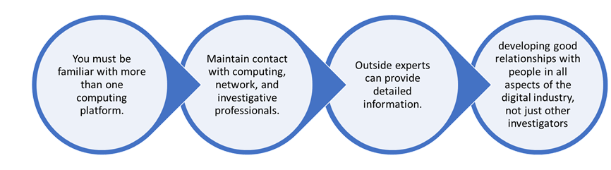
Outside experts can provide detailed information you need to retrieve digital evidence.
Several investigators have had to go through law enforcement contacts to get this information

Slide 21
Preparing for computer investigations
Computer investigations and forensics could be categorized several ways; and it falls into two distinct categories: public investigations and private or corporate investigation.
Public investigations involve government agencies responsible for criminal investigations and prosecution.
Government agencies range from local, county, and state or provincial police departments to federal regulatory enforcement agencies. These organizations must observe legal guidelines
Public investigations usually involve criminal cases and government agencies;

Slide 22
Private or corporate investigations, however, deal with private companies, non-law-enforcement government agencies.
These private organizations aren’t governed directly by criminal law but by internal policies that define expected employee behaviour and conduct in the workplace.
Although private investigations are usually conducted in civil cases, a civil case can develop into a criminal case

Slide 23
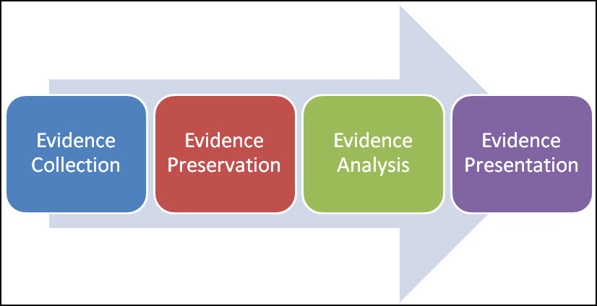
STAGES OF COMPUTER FORENSICS PROCESS

Slide 24
Identification Phase/ Evidence collection
The identification phase is the process of identifying evidence material and its probable location. Evidence should be handled properly. Basic requirement in evidence collection is evidence must be presented without alteration.
Once evidence collected, it is necessary to account for its whereabouts. Investigators would need detailed forensics to establish a chain of custody, the documentation of the possession of evidence.
Chain of custody is a vital part of computer forensics and the legal system and the goal is to protect the integrity of evidence, so evidence should be physically secured in a safe place along with a detailed log.

Slide 25
Acquiring data
Logical acquisition: involves creating a copy of the data on the storage device, without making any physical changes to the device. This method can be used to acquire data from hard drives, flash drives, and other types of storage media.
Physical acquisition: involves creating an exact bit-by-bit copy of the data on the storage device. This method is used when the device is damaged, or when a logical acquisition is not possible.
Live acquisition: involves collecting data from a running system, typically through the use of specialized software. This method can be used to acquire data from volatile memory, such as RAM, and can be useful in cases where the system is in use at the time of the acquisition.
Network acquisition: involves collecting data from a network, typically through the use of specialized software or hardware. This method can be used to acquire data from network devices, such as routers and switches, as well as data that is transmitted over the network.
Cloud acquisition: Involves collecting data from cloud-based services such as Google Drive, One Drive and Dropbox.

Slide 26
Acquisition Phase
The acquisition phase saves the state of evidence that can be further analyzed.
The goal of this phase is to save all digital values. Here, a copy of hard disk is created, which is commonly called as an image.
Different methods of acquiring.
As per law enforcement community, there are three catagories of commonly accepted forensics acquisition:
Mirror image – Bit by Bit
Forensics duplication - Logical Acquisition
Live acquisition.
Notes:
In cyber forensics, creating a mirror image (also known as a bit-by-bit copy) of a storage device, such as a hard drive, is a common practice for preserving the original data for forensic analysis. The process of creating a mirror image involves copying all the bits of data from the original storage device, including deleted files, slack space, and unallocated space, to a separate storage device. This creates an exact copy of the original data that can be used for forensic analysis without altering the original data. Bit-by-bit data acquisition is used to capture all the data on the storage device, and can be used to recover deleted or hidden files, as well as to investigate any potential data breaches.

Slide 27
A bitstream level copy, bit-by-bit level copy and sector-by-sector copy
A bitstream level copy captures all the data on a storage device at the lowest level possible, the bitstream level. This means that it copies each individual bit of data, including the metadata and file system information, from the original storage device to the new storage device. This method is the most secure and complete method of data acquisition in forensic analysis.
A bit-by-bit level copy, also known as a forensic duplicate, captures all the data on the storage device, including deleted files, slack space, and unallocated space. This method creates an exact copy of the original data that can be used for forensic analysis without altering the original data.
A sector-by-sector copy is similar to a bit-by-bit level copy, but it copies all the sectors of the original storage device, including empty or unused sectors, to the new storage device. This means that the new storage device will be an exact copy of the original storage device, including all the unused or empty space. This method is used when the exact layout of the disk is important.

Slide 28
Methods of acquisition
Mirror images, bit-for-bit copy, involve the backups of entire hard disk.
A forensic duplicate, sector-by-sector, is an advanced method that makes a copy of every bit without leaving any single bit of evidence. The resultant may be single large file and must be an exact representation of the original drive at bitstream level.
The forensic duplication process can be done with the help of tools like Forensic Tool Kit (FTK) imager, UNIX dd command etc
It is often desirable to capture volatile information, which is stored in RAM; it cannot be collected after the system has been powered down.
All currently running processes, open sockets, currently logged users, recent connections etc, are available in volatile information.

Slide 29
Analysis Phase
Forensic analysis is the process of understanding, recreating, and analyzing arbitrary events that have gathered from digital sources.
The analysis phase collects the acquired data and examines it to find the pieces of evidences.
This phase also identify that the system was tampered or not to avoid identification. Analysis phase examines all the evidence collected during collection and acquisition phases
Some of tools used in the analysis phase are Coroner, Encase, FTK.
The Coroner toolkit run under UNIX and EnCase is a toolkit that runs under Windows

Slide 30
Reporting Phase
The reporting phase comprises of documentation and evidence retention.
The scientific method used in this phase is to draw conclusions based on the gathered evidence.
This phase is mainly based on the Cyber laws and presents the conclusions for corresponding evidence from the investigation.

Slide 31
Forensics tools
FTK is developed by AccessData and is designed for use by forensic examiners, investigators, and incident responders.
It is a comprehensive tool that supports a wide range of analysis capabilities, including image acquisition, file analysis, and keyword searching.
EnCase, developed by Guidance Software, is also a comprehensive forensic tool and is widely used in the law enforcement and corporate sectors.
It features an intuitive interface, advanced searching and analysis capabilities, and the ability to preserve and present evidence in a forensically sound manner.

Slide 32
FTK features include:
EnCase features include:
Image acquisition and file analysis
Support for a wide range of file systems and operating systems
Advanced search capabilities, including keyword searching, regular expression searching, and hash searching
Advanced decoding and analysis of multiple types of data, including email, chat, and web data
Ability to create and analyze custom reports
Integration with other AccessData products for a comprehensive forensic analysis solution
Advanced search and indexing capabilities, including keyword and metadata searches
Support for a wide range of file systems and operating systems
Ability to analyze data from various sources, including computers, mobile devices, and cloud services
Advanced decoding and analysis of multiple types of data, including email, chat, and web data
Ability to create and analyze custom reports and dashboards
Integration with other Guidance Software products for a comprehensive forensic analysis solution

Slide 33
USES OF COMPUTER FORENSICS
A computer forensic examination may reveal when a document first appeared on a computer, when it was last edited, when it was last saved or printed and which user carried out these actions
• Intellectual Property theft
• Industrial espionage(spy)
• Employment disputes
• Fraud investigations
• Forgeries
• Bankruptcy investigations
• Inappropriate email and internet use in the work place

Slide 34
The objectives of Computer forensics are to provide guidelines for:
Designing procedures at a suspected crime scene to ensure that the digital evidence obtained is not corrupted.
Data acquisition and duplication.
Recovering deleted files and deleted partitions from digital media to extract the evidence and validate them.
Provide guidelines for analyzing digital media to preserve evidence, analysing logs and deriving conclusions, investigate network traffics and logs to correlate events, investigate wireless and web attacks, tracking emails and investigate email crimes.
Producing computer forensic report which provides complete report on computer forensic investigation process.
Preserving the evidence by following the chain of custody.

Slide 35
Private or corporate investigations
Establishing company policies
Warning banner
Authorized requester
Distinguishing Personal and Company Property
Establishing company policies
Published company policies provide a line of authority for a business to conduct internal investigations.
The line of authority states who has the legal right to initiate an investigation, who can take possession of evidence, and who can have access to evidence.

Slide 36
Corporate investigations
Corporate investigations in cyber forensics typically involve larger organizations seeking to gather evidence related to corporate fraud, intellectual property theft, or security incidents.
These investigations often involve multiple stakeholders and may require extensive analysis of electronic data and other digital assets.
Private investigations in cyber forensics refer to investigations performed by individuals or firms hired by individuals, businesses, or organizations to conduct digital forensic analysis on electronic devices or systems in a private or confidential manner.

Slide 37
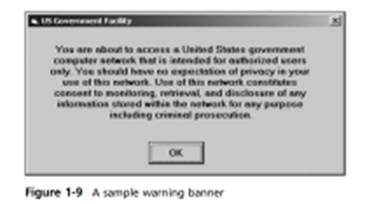
Warning banner
Another way a private or public organization can avoid litigation is to display a warning banner on computer screens
A warning banner usually appears when a computer starts or connects to the company intranet, network, or virtual private network (VPN) and informs end users that the organization reserves the right to inspect computer systems and network traffic at will.
Examples:
Access to this system and network is restricted.
Use of this system and network is for official business only.
Unauthorized or illegal users of this system or network will be subject to discipline or prosecution.

Slide 38
Authorized requester
In addition to using warning banners that state a company’s rights of computer ownership, businesses are advised to specify an authorized requester who has the power to conduct investigations.
Executive management should define this policy to avoid conflicts from competing interests between organizations or departments.
To avoid trivial or inappropriate investigations, executive management must also define and limit who is authorized to request a computer investigation and forensic analysis.

Slide 39
Distinguishing Personal and Company Property
Many company policies distinguish between personal and company computer property;
however, making this distinction can be difficult with PDAs, cell phones, and personal notebook computers.
Devices which can take out of company
E mails and files that could be used outside the company etc

Slide 40
Forensic laboratory certification
1. American Society of Crime Laboratory Directors (ASCLD)
2. National Accreditation Board for Testing and Calibration Laboratories (NABL)
3. American Board of Criminalistics (ABC)
4. Forensic Quality Services (FQS)
5. International Organization for Standardization (ISO
There are several accreditation bodies in India that provide forensic laboratory certification, including the
National Accreditation Board for Testing and Calibration Laboratories (NABL),
the Forensic Science Society of India (FSSI), and the
Bureau of Indian Standards (BIS).

Slide 41
Certification Process
Self-assessment: The laboratory must document and evaluate its own operations, procedures, and policies to ensure they meet the certification standards.
2. On-site inspection: An independent team of experts will conduct an on-site inspection of the laboratory to verify that it meets the certification standards.
3. Proficiency testing: The laboratory must participate in proficiency testing to demonstrate its ability to produce accurate and reliable results.
4. Audits: The laboratory must undergo regular audits to ensure that it continues to meet the certification standards.
5. Audits: The laboratory must undergo regular audits to ensure that it continues to meet the certification standards.

Slide 42
CYBER FORENSICS
Module 2

Slide 43
Data acquisition.
Data acquisition is the process of copying data. For computer forensics, it’s the task of collecting digital evidence from electronic media.
There are two types of data acquisition:
static acquisitions and live acquisitions.
The processes and data integrity requirements for static and live acquisitions are the same.
The only shortcoming with live acquisitions is not being able to perform repeatable processes, which are critical for collecting digital evidence.
With static acquisitions, if you have preserved the original media, making a second static acquisition should produce the same results.

Slide 44
Understanding Storage Formats for Digital Evidence .
Storage formats for digital evidence,
Raw Format- Old format
Examiners performed a bit-by-bit copy from one disk to another disk the same size or larger.
As a practical way to preserve digital evidence, vendors (and some OS utilities, such as the Linux/UNIX dd command) made it possible to write bit-stream data to files.
This copy technique creates simple sequential flat files of a suspect drive or data set.
The output of these flat files is referred to as a raw format.

Slide 45
Advantage vs disadvantage
The advantages of the raw format are fast data transfers and the capability to ignore minor data read errors on the source drive.
In addition, most computer forensics tools can read the raw format, making it a universal acquisition format for most tools.
One disadvantage of the raw format is that it requires as much storage space as the original disk or data set.
Another disadvantage is that some raw format tools, typically freeware versions, might not collect marginal (bad) sectors on the source drive

Slide 46
Raw image format: This format captures all the data on a storage device in its native format, including the file system, metadata, and slack space. It creates a bit-by-bit copy of the original storage device, which can be used for forensic analysis without altering the original data.
EnCase Image Format (E01): This is a proprietary format developed by Guidance Software, which is widely used in forensic investigations. It creates a bit-by-bit copy of the original storage device and allows for compression, encryption, and split files.
Advanced Forensic Format (AFF): This is an open-source format developed by the AFF Project, which is designed to be a more efficient and flexible alternative to other image formats. It supports multiple compression and encryption options and allows for split files.
File system level copy: This format captures data from file systems like NTFS, FAT, HFS, and ext4 in a file-by-file fashion. This format is used when the goal is to collect data that is accessible via the file system.

Slide 47
Validation
A validation check by using Cyclic Redundancy Check (CRC-32)
Message Digest 5 (MD5),
Secure Hash Algorithm (SHA-1 or newer) hashing functions.
These validation checks, however, usually create a separate file containing the hash value.
Notes:
Output size: MD5 generates a 128-bit (16-byte) output, whereas SHA generates a larger output size, depending on the specific algorithm used. For example, SHA-1 generates a 160-bit (20-byte) output, while SHA-256 generates a 256-bit (32-byte) output.
Security: MD5 is considered less secure than SHA due to known collision attacks, which means that it is possible for an attacker to create two different inputs that produce the same output. SHA-1 is also considered less secure than SHA-2 and SHA-3.
Usage: Both MD5 and SHA are used in various cryptographic applications, such as digital signatures, message authentication, and password hashing, but due to the known collision attacks on MD5 and the advancement in technology, it is recommended to use at least SHA-256 or SHA-3 for cryptographic applications.

Slide 48
. Proprietary Formats
Proprietary formats typically offer several features that complement the vendor’s analysis tool, such as the following:
The option to compress or not compress image files of a suspect drive, thus saving space on the target drive
The capability to split an image into smaller segmented files for archiving purposes, such as to CDs or DVDs, with data integrity checks integrated into each segment
The capability to integrate metadata into the image file, such as date and time of the acquisition, hash value (for self-authentication) of the original disk or medium, investigator or examiner name, and comments or case details

Slide 49
Disadvantage
One major disadvantage of proprietary format acquisitions is the inability to share an image between different vendors’ computer forensics analysis tools.
For example, the ILook imaging tool IXimager produces three proprietary formats—IDIF, IRBF, and IEIF—that can be read only by ILook.
Another problem with proprietary and raw formats is a file size limitation for each segmented volume.
Of all the proprietary formats for image acquisitions, the Expert Witness format is currently the unofficial standard.
This format, the default for Guidance Software EnCase, produces both compressed and uncompressed image files.

Slide 50
Advanced Forensic Format (AFF)
Dr. Simson L. Garfinkel of Basis Technology Corporation recently developed a new opensource acquisition format called Advanced Forensic Format (AFF).
This format has the following design goals:
• Creating compressed or uncompressed image files
• No size restriction for disk-to-image files
• Providing space in the image file or segmented files for metadata
• Open source for multiple computing platforms and OSs
• Offer internal consistency checks for self-authentication

Slide 51
Determining the best acquisition method,
Static acquisitions and live acquisitions.
If the computer has an encrypted drive, a live acquisition is done if the password or passphrase is available—meaning the computer is powered on and has been logged on to by the suspect.
Static acquisitions are always the preferred way to collect digital evidence.
However, they do have limitations in some situations, such as an encrypted drive that’s readable only when the computer is powered on

Slide 52
Method to use for an investigation
To determine which acquisition method to use for an investigation,
consider the size of the source (suspect) disk,
whether you can retain the source disk as evidence or must return it to the owner,
how much time you have to perform the acquisition, and where the evidence is located.

Slide 53
four methods
For both types of acquisitions, data can be collected with four methods:
creating a diskto-image file,
creating a disk-to-disk copy,
creating a logical disk-to-disk or disk-to-data file, or
creating a sparse copy of a folder or file.

Slide 54
Disk-to-image file: This method creates a copy of an entire disk, including the file system and all data, and saves it as a single image file. This image file can be used to create an exact replica of the original disk, or to restore the data in case of a failure. Common tools used for this method include dd, Ghost, and Acronis True Image.
Disk-to-disk copy: This method creates a copy of an entire disk and saves it to another disk. This can be used to create a backup of a disk, or to clone a disk to another disk with the same or larger capacity. Common tools used for this method include dd, Ghost, and Acronis True Image.
Logical disk-to-disk or disk-to-data file: This method creates a copy of selected files or folders from a disk, rather than copying the entire disk. This can be useful for creating backups of specific data or for copying data between disks. Common tools used for this method include rsync, Robocopy and Windows backup.
Sparse copy of a folder or file: This method creates a copy of selected files or folders but only copies the used blocks and mark the unused blocks as "holes" in the copy. This can save disk space and time when copying large files with many unused blocks. Common tools used for this method include rsync and cp ( with -S flag)

Slide 55
Creating a disk-to-image file
Creating a disk-to-image file is the most common method and offers the most flexibility for your investigation.
With this method, you can make one or many copies of a suspect drive.
These copies are bit-for-bit replications of the original drive.
You can use other forensics tools, such as ProDiscover, EnCase, FTK

Slide 56
Sometimes you can’t make a disk-to-image file because of hardware or software errors or incompatibilities.
This problem is more common when you have to acquire older drives. For these drives, you might have to create a disk-to-disk copy of the suspect drive.
Several imaging tools can copy data exactly from an older disk to a newer disk.
These programs can adjust the target disk’s geometry (its cylinder, head, and track configuration) so that the copied data matches the original suspect drive.

Slide 57
logical acquisition or sparse acquisition
Collecting evidence from a large drive can take several hours.
If your time is limited, consider using a logical acquisition or sparse acquisition data copy method.
A logical acquisition captures only specific files of interest to the case or specific types of files.
A sparse acquisition is similar but also collects fragments of unallocated (deleted) data; use this method only when you don’t need to examine the entire drive.

Slide 58
An example of a logical acquisition is an e-mail investigation that requires collecting only Outlook .pst or .ost files.
Another example is collecting only specific records from a large RAID server.
If you have to recover data from a RAID server with several terabytes (TBs) of data storage, the logical method might be the only way you can acquire the evidence.

Slide 59
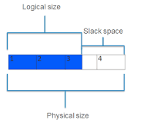
Compression
Older Microsoft disk compression tools, such as DoubleSpace or DriveSpace, eliminate only slack disk space between files.
Other compression methods use an algorithm to reduce file size. Popular archiving tools, such as PKZip, WinZip, and WinRAR, use an algorithm referred to as lossless compression.
Compression algorithms for graphics files use what’s called lossy compression, which can change data.
An easy way to test lossless compression is to perform an MD5 or SHA-1 hash on a file before and after it’s compressed.
If the compression is done correctly, both versions have the same hash value.

Slide 60
Message Digest Algorithm
The MD5 algorithm is intended for digital signature applications, where a large file must be 'compressed' in a secure manner before being encrypted with a private (secret) key under a public-key cryptosystem
In cryptography, SHA-1 (Secure Hash Algorithm 1) is a cryptographically broken but still widely used hash function which takes an input and produces a 160-bit (20-byte) hash value

Slide 61
Contingency planning for image acquisitions,
Precautions needed to protect digital evidence
Contingency plans in case of software or hardware failure
Importance of creating a duplicate of disk-to-image file
Making at least two images of collected digital evidence using different tools
Standard practice of using multiple imaging tools for reliability.

Slide 62
Many acquisition tools don’t copy data in the host protected area (HPA) of a disk drive.
The Host Protected Area (HPA) as defined is a reserved area on a Hard Disk Drive (HDD).It was designed to store information in such a way that it cannot be easily modified, changed, or accessed by the user, BIOS, or the OS.
Computer manufacturers may use the area to contain a preloaded OS for install and recovery purposes (instead of providing DVD or CD media).
For these situations, consider using a hardware acquisition tool that can access the drive at the BIOS level
Definition: Host Protected Area (HPA) is a section of a hard disk drive that is reserved and not accessible to the end user or the operating system.
Purpose: The HPA is used to store important data for the functioning of the drive such as diagnostic information, factory settings, and firmware updates.
Accessibility: The HPA is not accessible to the end user or the operating system, and its size can be modified by the manufacturer or special software utilities.

Slide 63
Contingency planning
As part of your contingency planning, you must be prepared to deal with encrypted drives.
A static acquisition on most whole disk encrypted drives currently involves decrypting the drives, which requires the user’s cooperation in providing the decryption key.
Most whole disk encrypted tools at least have a manual process for decrypting data, which is converting the encrypted disk to an unencrypted disk.
This process can take several hours, depending on the disk size.
One good thing about encryption use is that data isn’t altered, in that free and slack space aren’t changed.
Researchers at Princeton University have produced a technique to recover passwords and passphrases from RAM

Slide 64
Using acquisition tools,
Many computer forensics software vendors have developed acquisition tools that run in Windows
Windows can easily contaminate your evidence drive, you must protect it with a well-tested write-blocking hardware device.
Another drawback is that most Windows tools can’t acquire data from a In additdisk’s host protected area.
ion, some countries haven’t yet accepted the use of write-blocking devices for data acquisitions.

Slide 65
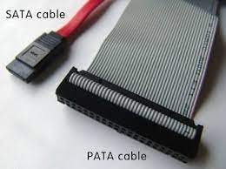
Windows XP Write-Protection with USB Device
When Microsoft updated Windows XP with Service Pack 2 (SP2), a new feature was added to the Registry: The USB write-protection feature blocks any writing to USB devices.
On your acquisition workstation, simply connect the suspect drive to the USB external drive or connector after you’ve modified the Windows Registry to enable write-protection.
The disadvantage is that your target drive needs to be connected to an internal PATA (IDE), SATA, or SCSI controller, not another USB external drive.
Notes:
The registry helps Windows manage and operate your computer, ensuring access to critical resources and helping important programs configure settings. A hierarchical database structure of keys and values makes up the registry.

Slide 66
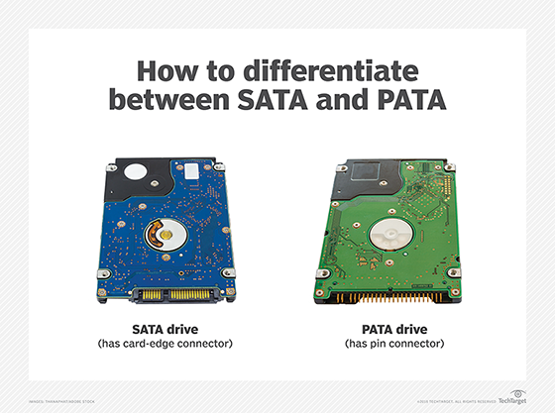
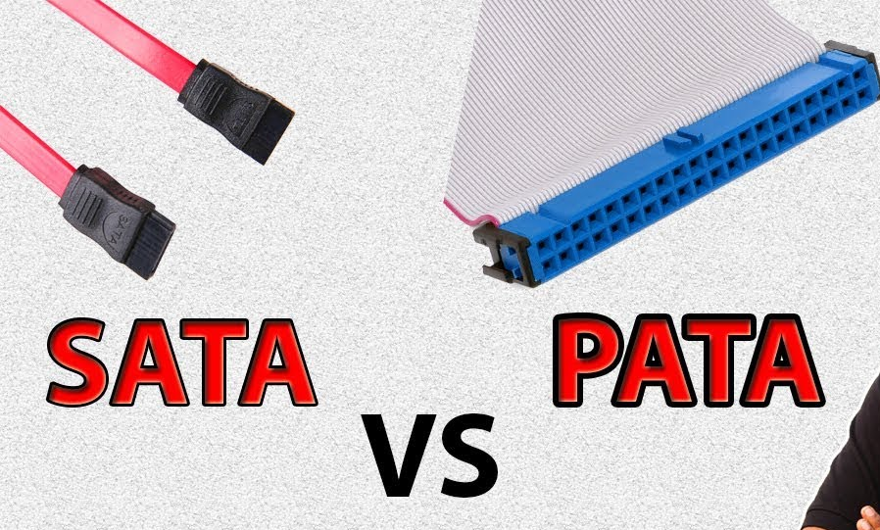

Slide 67
Steps
To update the Registry, you need to perform three tasks.
First, back up the Registry in case something fails while you’re modifying it.
Second, modify the Registry with the write protection feature.
Third, create two desktop icons to automate switching between enabling and disabling writes to the USB device

Slide 68
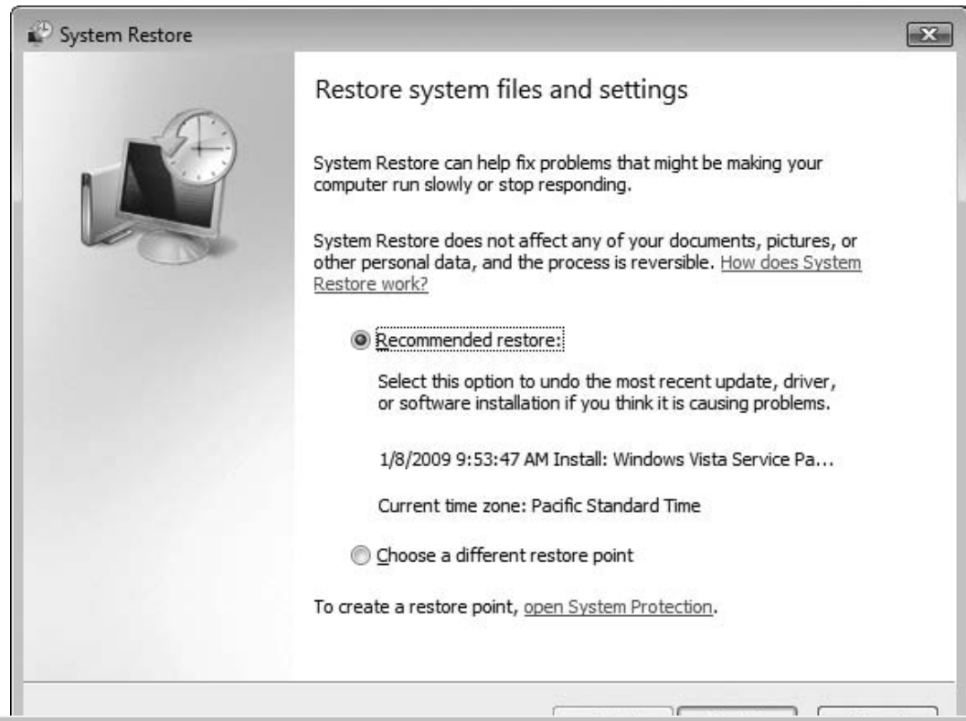
Backing Up the Registry
1. Click Start, point to All Programs, point to Accessories, point to System Tools, and click System Restore. When the message box opens, click Continue.
2. In the first window of the System Restore Wizard (see Figure), click the open System Protection link to create a restore point.
3. In the System Properties dialog box
(see Figure), click the Create button.

Slide 69
Modifying the Registry for USB Write-Blocking
1. Click Start, type regedit in the Start Search text box, and then press Enter. If the message box opens, click Continue. (In Windows XP, click Start, Run, type regedit, and click OK.)
2. In Registry Editor, navigate to and click to expand the \HKEY_LOCAL_MACHINE\ SYSTEM\CurrentControlSet key.
3. Under the CurrentControlSet item, right-click the Control subkey, point to New, and then click Key
4. Registry Editor then prompts you for a key name. Type StorageDevicePolicies and press Enter.
5. Right-click the newly created StorageDevicePolicies descendent key, point to New, and click DWORD Value.
A new prompt appears in the key data area at the right. Type WriteProtect and press Enter.
In the Edit DWORD Value dialog box, change the Value Data setting from 0 to 1, and then click OK to activate write-blocking to USB devices.

Slide 70
Automating USB Write-Blocking
To minimize errors in updating the Registry every time you need to write-block a USB device, exporting the Registry is recommended.
1. Right-click the StorageDevicePolicies descendent key and click Export.
2. In the Export Registry File dialog box, click Desktop in the Save in list box. In the File name text box, type Write Protect USB ON, and click Save

Slide 71
Acquiring Data with a Linux Boot CD
The Linux OS has many features that are applicable to computer forensics, especially data acquisitions.
One unique feature is that Linux can access a drive that isn’t mounted.
Physical access for the purpose of reading data can be done on a connected media device, such as a disk drive, a USB drive, or other storage devices.
For example, a Windows XP or Linux kernel 2.6 or later workstation automatically accesses a suspect drive when connecting to it, which could alter data.

Slide 72
Using Linux Live CD Distributions
Several Linux distributions, such as Knoppix (www.knoppix.org), provide an ISO image that can be burned to a CD or DVD. Linux ISO images are referred to as Live CDs.
A few Linux ISO images are specifically designed for computer forensics, however.
They are also configured not to mount, or to mount as read-only, any connected storage media, such as disk drives.
This feature protects the media’s integrity for the purpose of acquiring and analyzing data.
To access media, you have to give specific instructions to the Live CD boot session through a GUI utility or a shell command prompt.

Slide 73
Linux Live CDs for computer forensics
The following are well-designed Linux Live CDs for computer forensics:
• Helix (www.e-fense.com/helix/; English interface)
• Penguin Sleuth (www.linux-forensics.com; English interface)
• FCCU (www.d-fence.be; French interface
Remember to check your workstation’s BIOS to see whether it boots first from the CD or DVD on the system. To test the Live CD, simply place it in the CD or DVD drive and reboot your system.

Slide 74
Acquiring Data with dd in Linux
A unique feature of a forensic Linux Live CD is that it can mount and read most drives. To perform a data acquisition on a suspect computer, all you need are the following:
• A forensic Linux Live CD
• A USB, FireWire, or SATA external drive with cables
• Knowledge of how to alter the suspect computer’s BIOS to boot from the Linux Live CD
• Knowledge of which shell commands to use for the data acquisition
The dd command, available on all UNIX and Linux distributions, means “data dump.” This command, with many functions and switches, can be used to read and write data from a media device and a data file.

Slide 75
Acquiring Data with dcfldd in Linux
The dd command is intended as a data management tool; it’s not designed for forensics acquisitions.
Because of these shortcomings, Nicholas Harbour of the Defense Computer Forensics Laboratory (DCFL) developed a tool that can be added to most UNIX/Linux OSs.
This tool, the dcfldd command, works similarly to the dd command but has many features designed for computer forensics acquisitions

Slide 76
Example
dd if=/dev/sdb of=data_image.img bs=1M
In this example, the if option specifies the input file, which is /dev/sdb, which is the block device file for the storage device.
The of option specifies the output file, which will be a file named data_image.img that will contain the raw data from the storage device.
The bs option specifies the block size, which is set to 1M in this example, meaning that dd will read 1 megabyte of data at a time.

Slide 77
The following are important functions dcfldd offers that aren’t possible with dd
• Specify hexadecimal patterns or text for clearing disk space.
• Log errors to an output file for analysis and review.
• Use the hashing options MD5, SHA-1, SHA-256, SHA-384, and SHA-512
• Refer to a status display indicating the acquisition’s progress in bytes.
• Split data acquisitions into segmented volumes with numeric extensions (unlike dd’s limit of 99).
• Verify the acquired data with the original disk or media data.

Slide 78
Validating Data Acquisitions
Probably the most critical aspect of computer forensics is validating digital evidence.
The weakest point of any digital investigation is the integrity of the data you collect, so validation is essential.
Validating digital evidence requires using a hashing algorithm utility, which is designed to create a binary or hexadecimal number that represents the uniqueness of a data set, such as a file or disk drive.
This unique number is referred to as a “digital fingerprint.” Because hash values are unique, if two files have the same hash values, they are identical

Slide 79
Making any alteration in one of the files—even changing one letter from uppercase to lowercase—produces a completely different hash value,
In recent years, researchers have discovered that MD5 can produce collisions.
For forensic examinations of data files on a disk drive, however, collisions are of little concern.
If two files with different content have the same MD5 hash value, a comparison of each byte of a file can be done to see the differences. Currently, several tools can do a byte-by-byte comparison of files.

Slide 80
For imaging an evidence drive, many tools offer validation techniques ranging from CRC32, MD5, and SHA-1 to SHA-512.
The advantage of older validation utilities, such as CRC-32, is speed because it takes less CPU processing time to compute hash values.
More advanced validation utilities, such as MD5 and the SHA series, require far more CPU cycles to complete.

Slide 81
Linux Validation Methods
Linux and UNIX are rich in commands and functions. The two Linux shell commands shown earlier
, dd and dcfldd, have several options that can be combined with other commands to validate data.
The dcfldd command has additional options that validate data collected from an acquisition.
Validating acquired data with the dd command requires using other shell commands.

Slide 82
Windows Validation Methods
Unlike Linux and UNIX, Windows has no built-in hashing algorithm tools for computer forensics.
However, many Windows third-party programs do provide a variety of built-in tools.
These third-party programs range from hexadecimal editors, such as X-Ways WinHex or Breakpoint Software Hex Workshop, to computer forensics programs, such as ProDiscover, EnCase, and FTK.

Slide 83
Performing RAID Data Acquisitions
Size is the biggest concern because many RAID systems are now pushing into many terabytes of data.
Redundant array of independent disks (RAID) is a computer configuration involving two or more disks.
Originally, RAID was developed as a data-redundancy measure to minimize data loss caused by a disk failure.
As technology improved, RAID also provided increased storage capabilities.

Slide 84
For a high-end data-processing environment, RAID 5 is common and is often based in special RAID towers.
These high-end RAID systems usually have integrated controllers that connect to high-end servers or mainframes.
These systems provide redundancy and high-speed data access and can make many small disks appear as one very large drive.

Slide 85
RAID levels:
RAID 0 – striping
RAID 1 – mirroring
RAID 5 – striping with parity
RAID 6 – striping with double parity
RAID 10 – combining mirroring and striping

Slide 86
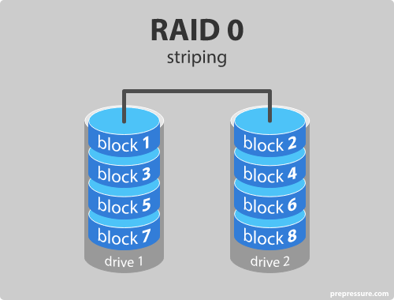
RAID level 0 – Striping
In a RAID 0 system data are split up into blocks that get written across all the drives in the array.
By using multiple disks (at least 2) at the same time, this offers superior I/O performance.
This performance can be enhanced further by using multiple controllers, ideally one controller per disk.
Notes:
RAID 0: Striping without parity. Increases performance but provides no data redundancy. If one drive fails, all data is lost.
RAID 1: Mirroring. Provides data redundancy by writing the same data to multiple disks. If one drive fails, the other drive continues to function. However, capacity is limited to the size of the smallest drive.
RAID 5: Striping with distributed parity. Provides data redundancy by writing parity data across all drives. If one drive fails, the data can be reconstructed from the remaining drives. However, write performance is slower than RAID 0 or RAID 1.

Slide 87
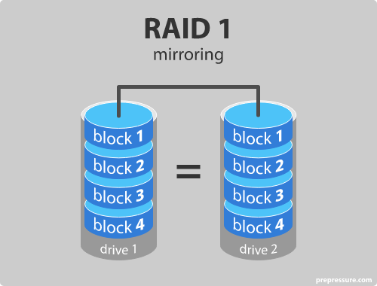
RAID level 1 – Mirroring
Data are stored twice by writing them to both the data drive (or set of data drives) and a mirror drive (or set of drives).
If a drive fails, the controller uses either the data drive or the mirror drive for data recovery and continuous operation. You need at least 2 drives for a RAID 1 array.

Slide 88
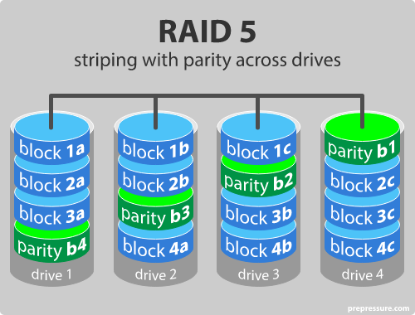
RAID level 5 – Striping with parity
RAID 5 is the most common secure RAID level. It requires at least 3 drives but can work with up to 16.
Data blocks are striped across the drives and on one drive a parity checksum of all the block data is written.
The parity data are not written to a fixed drive, they are spread across all drives, as the drawing below shows.

Slide 89
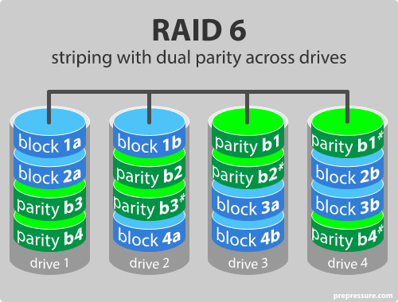
RAID level 6 – Striping with double parity
RAID 6 is like RAID 5, but the parity data are written to two drives.
That means it requires at least 4 drives and can withstand 2 drives dying simultaneously.
The chances that two drives break down at exactly the same moment are of course very small.

Slide 90
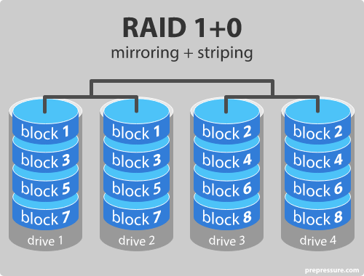
RAID level 10 – combining RAID 1 & RAID 0
It is possible to combine the advantages (and disadvantages) of RAID 0 and RAID 1 in one single system.
This is a nested or hybrid RAID configuration. It provides security by mirroring all data on secondary drives while using striping across each set of drives to speed up data transfers.

Slide 91
Acquiring RAID Disks
There’s no simple method for getting an image of a RAID server’s disks. You need to address the following concerns:
How much data storage is needed to acquire all data for a forensics image?
What type of RAID is used?
Do you have an acquisition tool capable of copying the data correctly?
Can the tool read a forensically copied RAID image?
Can the tool read split data saves of each RAID disk, and then combine all images of each disk into one RAID virtual drive for analysis?

Slide 92
Under ideal circumstances, your goal is to collect a complete image of evidence drives.
Because RAID systems can have dozens or more terabytes of data storage, copying all data isn’t always practical, as you would for a small desktop or laptop computer.
For these occasions, retrieving only the data relevant to the investigation with the sparse or logical acquisition method is the only practical solution.

Slide 93
Using Remote Network Acquisition Tools
Recent improvements in computer forensics tools include the capability to acquire disk data or data fragments (sparse or logical) remotely.
With this feature, you can connect to a suspect computer remotely via a network connection and copy data from it. Remote acquisition tools vary in configurations and capabilities.
Some require manual intervention on remote suspect computers to initiate the data copy.
Others can acquire data surreptitiously through an encrypted link by pushing a remote access program to the suspect’s computer.

Slide 94
Challenges
For example, if you have access to the LAN as the suspect’s computer, data transfer speeds and routing table conflicts could cause problems.
On a WAN, you have the problem of gaining the permissions needed to access more secure subnets.
In addition, heavy traffic on the network could cause delays and errors during the acquisition, no matter what tool you’re using.
Another problem is the remote access program being detected by antivirus, antispyware, and firewall tools.

Slide 95
Remote Acquisition with ProDiscover
Two versions of ProDiscover can perform remote acquisitions: ProDiscover Investigator and ProDiscover Incident Response.
When connected to a remote computer, both tools use the same ProDiscover acquisition method
. After the connection is established, the remote computer is displayed in the Capture Image dialog box
Notes:
ProDiscover provides a wide range of features, including:
Data preview and recovery: The software can preview and recover lost or deleted files, even if the file system is damaged or corrupted.
File searching: ProDiscover allows you to search for specific files or keywords, making it easy to find relevant evidence in a large dataset.
File carving: The software can recover files that have been deleted or overwritten by carving them out of unallocated space on the disk.
Imaging: ProDiscover can create an exact copy of a storage device, known as a "forensic image," which can be used for analysis and evidence preservation.
Analysis: The software includes a range of analysis tools that can help to uncover information about the file system, partitions, and metadata on the storage device.
Reporting: ProDiscover can generate detailed reports that can be used in legal proceedings or investigations.

Slide 96
ProDiscover Investigator is designed to capture data from a suspect’s computer while the user is operating it, which is a live acquisition. Being able to connect to a suspect’s computer directly allows the following capabilities:
Preview a suspect’s drive remotely while it’s in use or powered on.
Perform a live acquisition while the suspect’s computer is powered on
Encrypt the connection between the suspect’s and examiner’s computers.
Copy the suspect computer’s RAM while the computer is powered on.
Use the optional stealth mode to hide the remote connection from the suspect while data is previewed or acquired.

Slide 97
ProDiscover Incident Response is designed to be integrated as a network intrusion analysis tool.
• Capture volatile system state information.
• Analyze current running processes on a remote system.
• Locate unseen files and processes on a remote system that might be running malware or spyware.
• Remotely view and listen to IP ports on a compromised system.
• Run hash comparisons on a remote system

Slide 98
This remote agent can be installed in three different ways:
• Trusted CD—For this manual installation method, ProDiscover can create a special CD containing the PDServer remote agent. This CD is used to load PDServer manually on the suspect computer.
• Preinstallation—For networks with a configured OS, PDServer remote agent can be added to the standard installation of high-risk computers, which enables network security administrators to respond to network attacks
• Pushing out and running remotely—Downloading PDServer to a remote computer helps investigators respond quickly to incidents. Data is collected in real time when using this function.

Slide 99
Processing Law Enforcement Crime Scenes:
The first step in processing a crime scene is to secure the scene and ensure that no one enters or leaves until all the evidence has been collected.
Next, an initial walk-through of the scene should be conducted to identify any physical evidence and to determine what further steps are necessary.
In a cybercrime scene, physical evidence might include computers, hard drives, flash drives, phones, and other digital storage devices.
When collecting digital evidence, it is important to follow a consistent and well-documented process, such as the “ACQUIP” process:
Acquire a copy of the digital evidence without altering the original.
Chain of custody documentation should be maintained to ensure the evidence can be used in court.
Quickly triage the data to determine what is relevant to the investigation.
Understand the data and its context.
Image the data to a write-protected media for analysis.
Preserve the integrity of the data to ensure that it can be used as evidence in court.

Slide 100
Preparing for a Search:
Before conducting a search, it is important to obtain the proper legal authority, such as a search warrant or consent from the owner of the property to be searched.
A search plan should be developed to ensure that all relevant areas and devices are searched and that the search is conducted in a systematic and thorough manner.
When searching for digital evidence, it is important to search for both active and inactive data, as well as data that may be hidden or encrypted.
The search should be documented, and all evidence should be properly labeled and secured to maintain the chain of custody.

Slide 101
Securing a Computer Incident or Crime Scene:
The first step in securing a computer incident or crime scene is to disconnect the device from the network to prevent the destruction of evidence.
Next, the scene should be secured to prevent unauthorized access and to preserve the chain of custody.
If necessary, a digital forensics expert should be consulted to assist with the preservation and acquisition of digital evidence.

Slide 102
Seizing Digital Evidence at the Scene:
When seizing digital evidence, it is important to follow a consistent and well-documented process to ensure the evidence is properly collected and preserved.
The following steps should be followed when seizing digital evidence:
Secure the scene and maintain the chain of custody.
Identify the type of device and its operating system.
Make a forensic image of the device's storage media.
Document the process and label the evidence.
Store the evidence in a secure location.

Slide 103
Storing Digital Evidence:
Digital evidence should be stored in a secure location, such as a digital forensics lab or a secure storage facility.
The storage facility should have proper climate control, fire suppression, and backup systems to ensure the integrity and preservation of the evidence.
The chain of custody should be maintained, and access to the evidence should be limited to authorized personnel.
The evidence should be securely stored until it is no longer needed for the investigation or legal proceedings.

